Slide 1
TE-MSC-MDT

Slide 2
MQXFS-201
Reaction report
N. Bourcey
30/09/2015

Slide 3
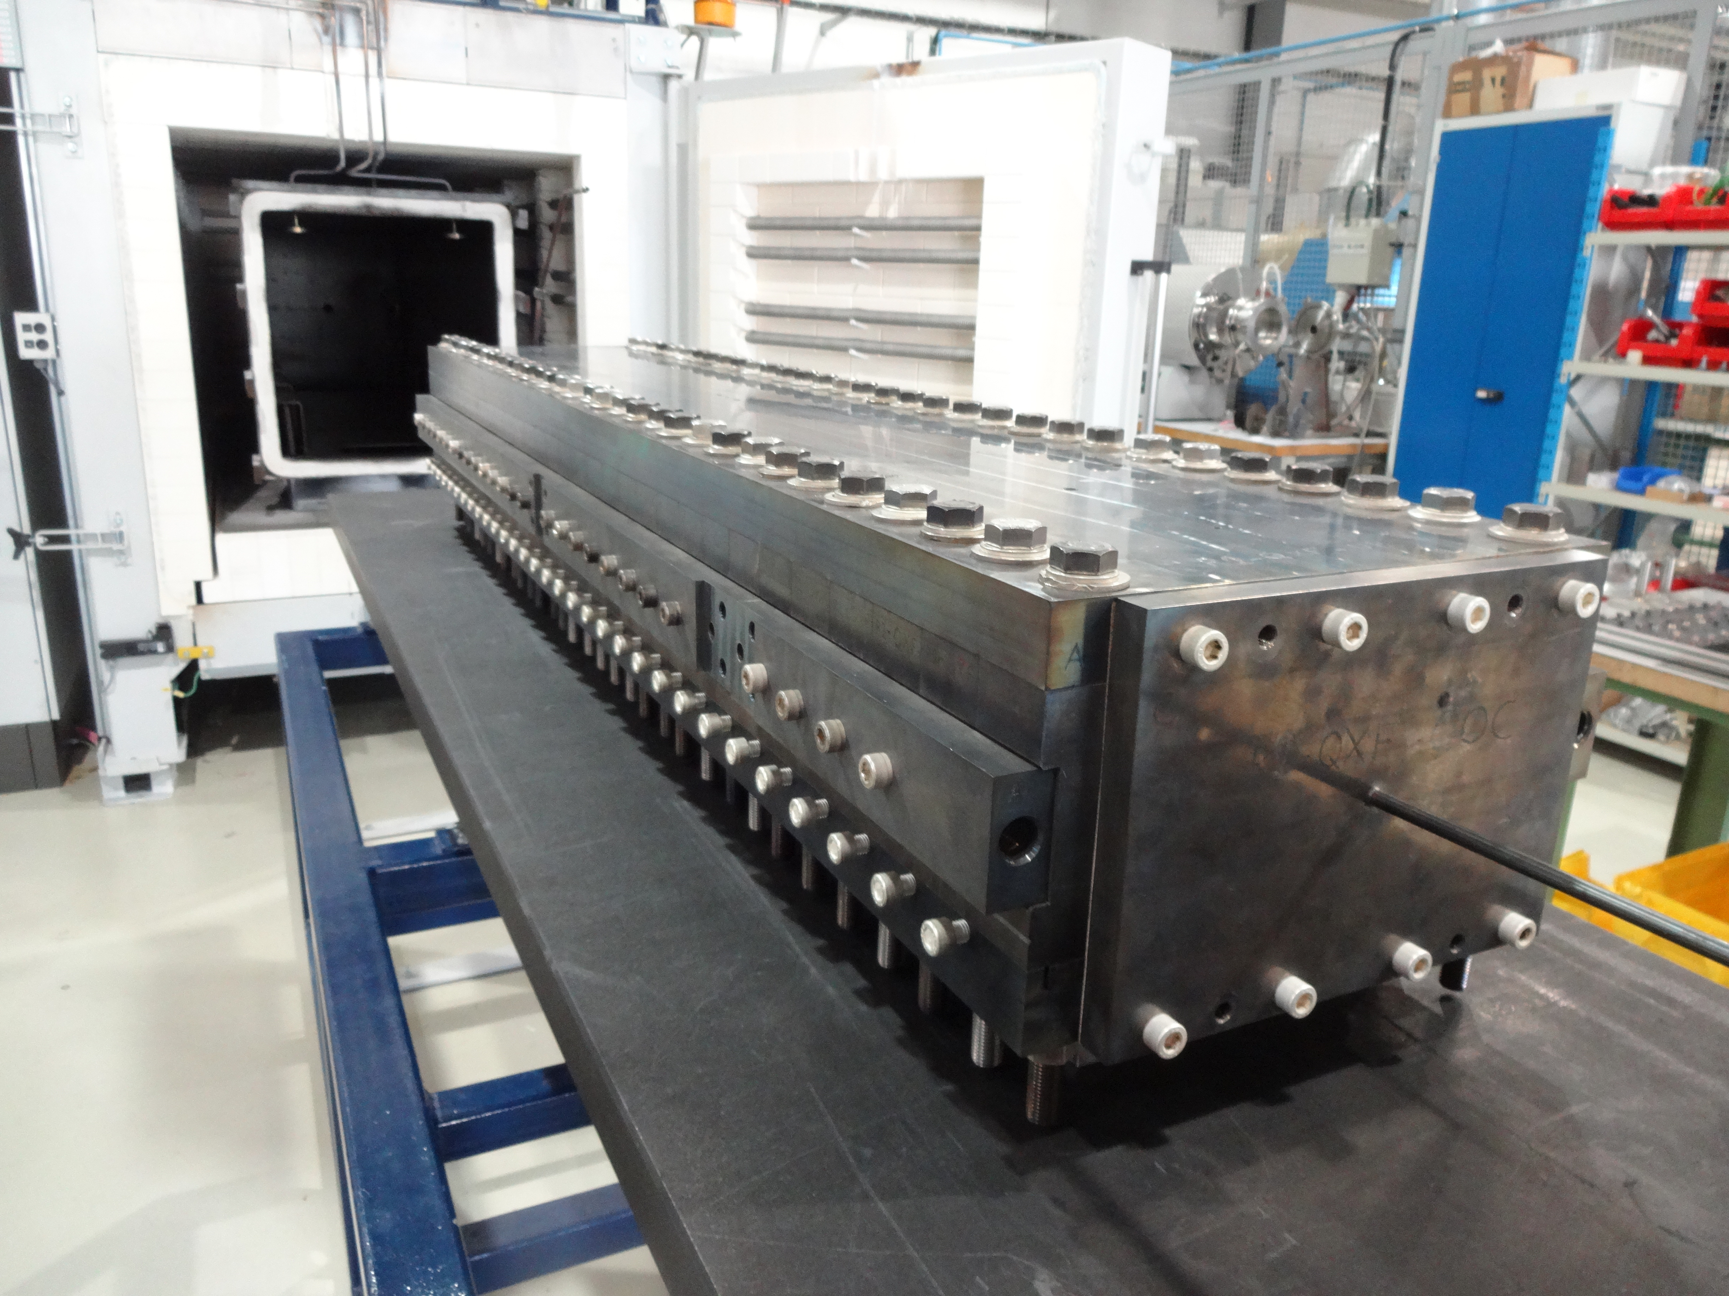
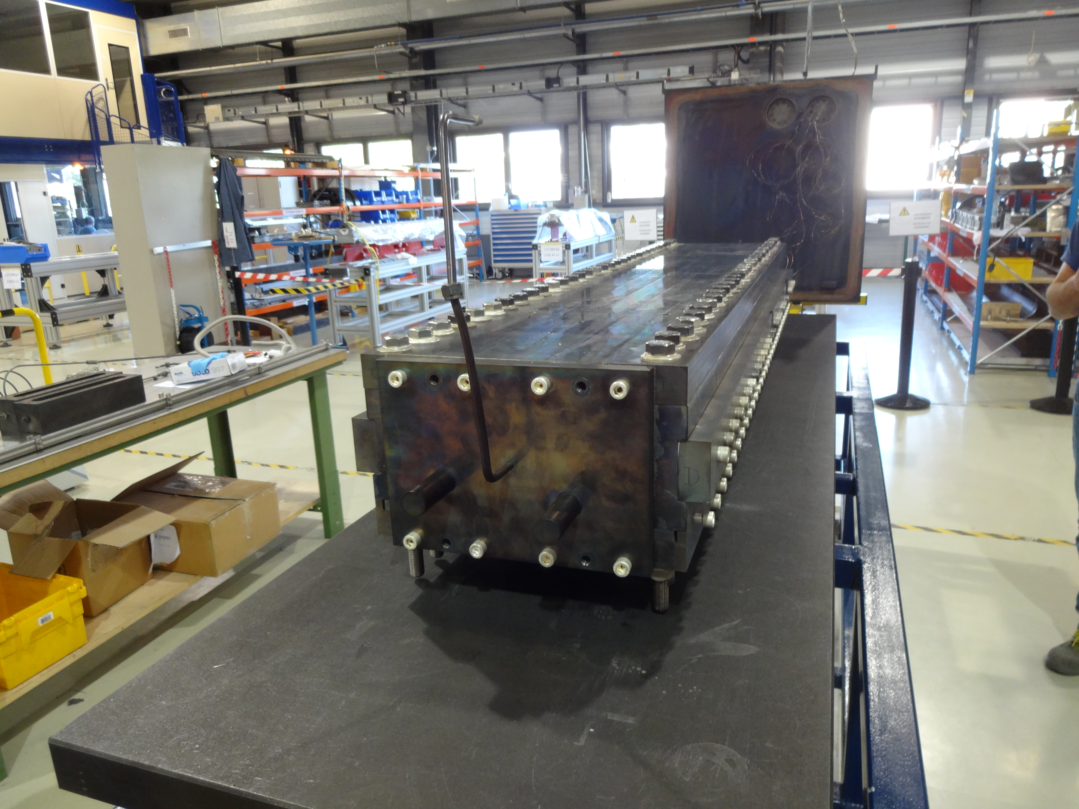
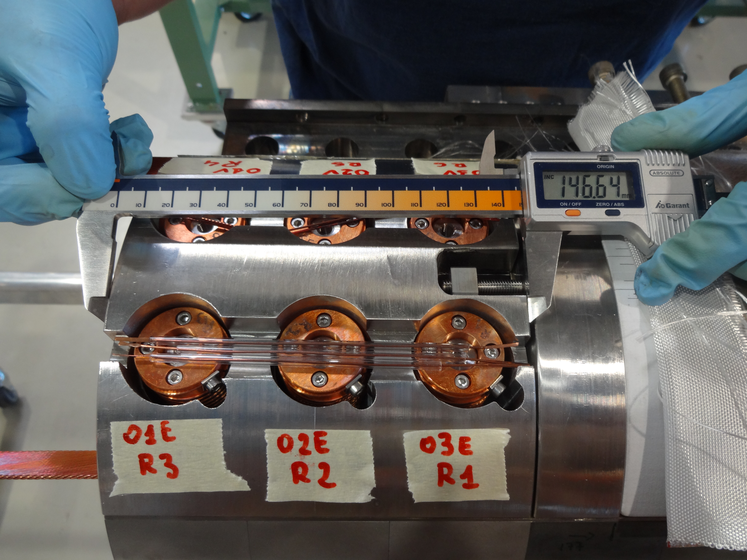
Preparation
Start date: 10/08/2015
End date: 25/08/2015
Cable ref: H16EC0188A
Heat cycle :
Ramp 50°C/h, hold 120h/610°C
Ramp 50°C/h, hold 140h/630°C

Slide 4
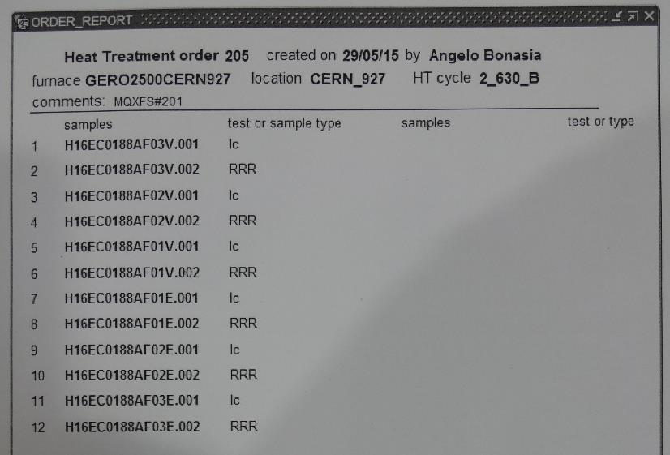
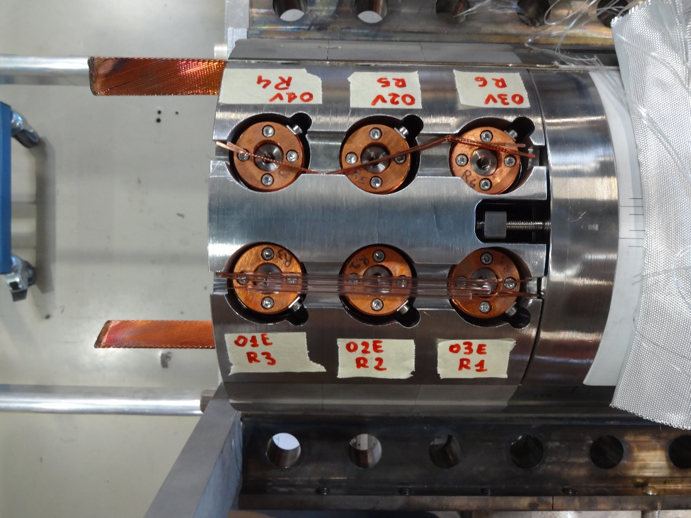
Reaction MQXFS-201 – instrumentation layout
tc7
tc9
tc6

Slide 5
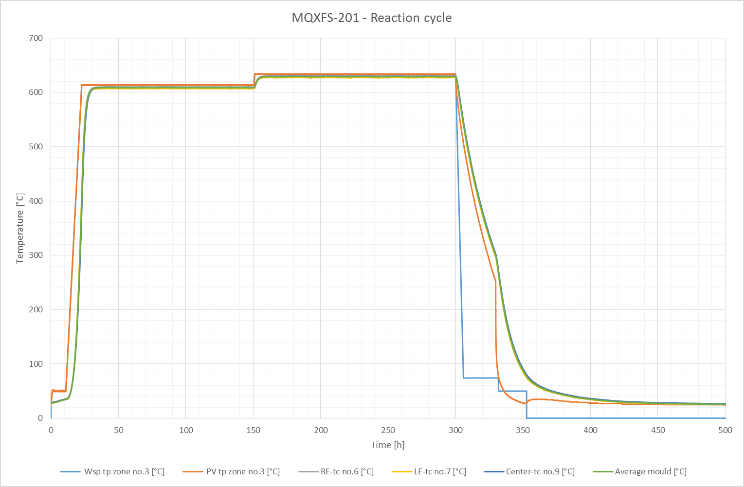

Slide 6
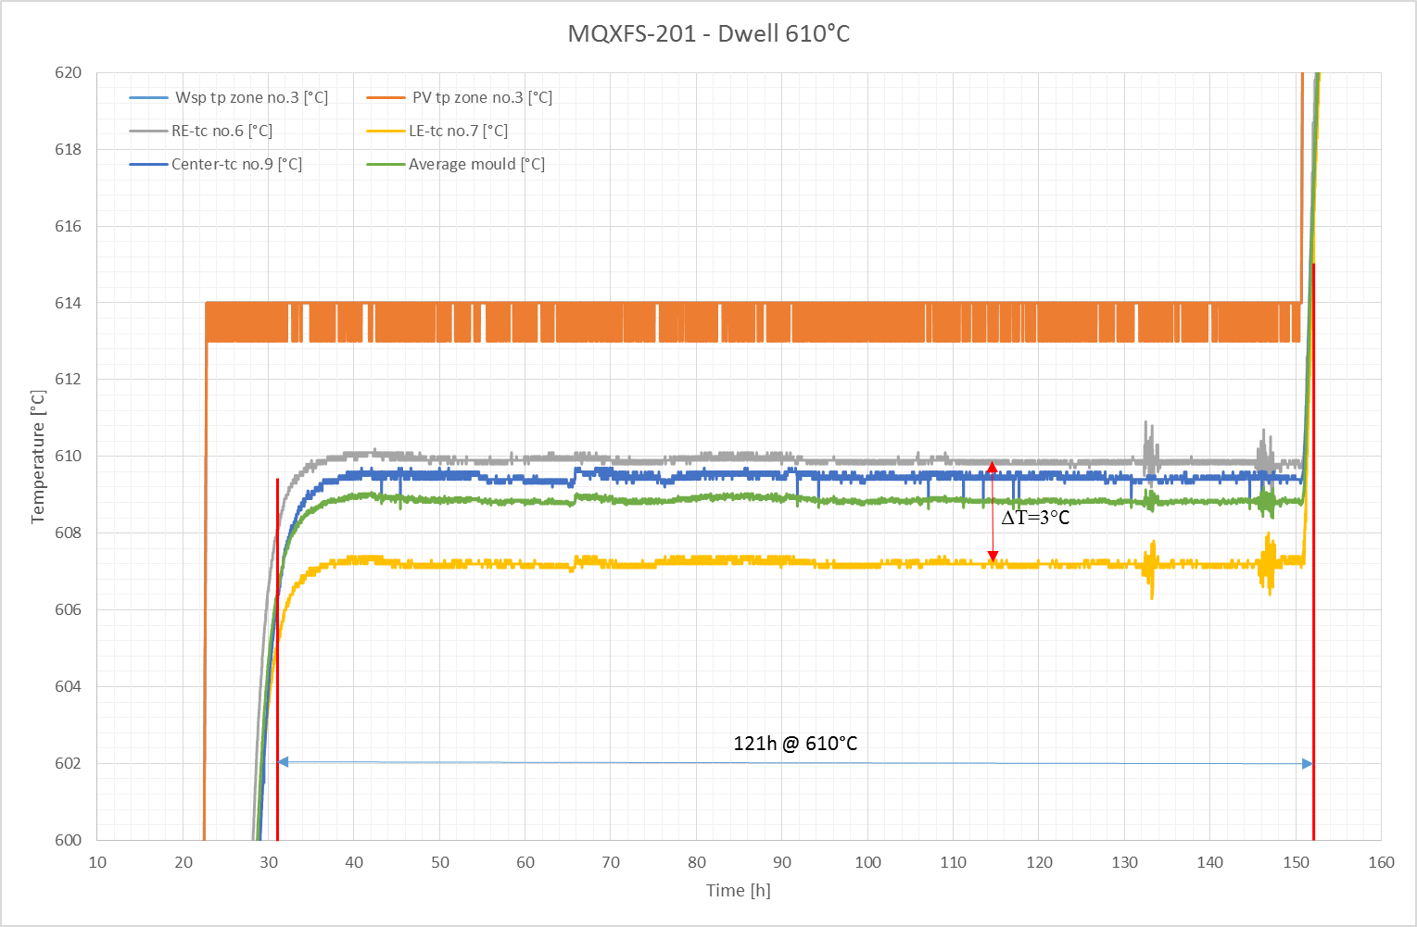

Slide 7
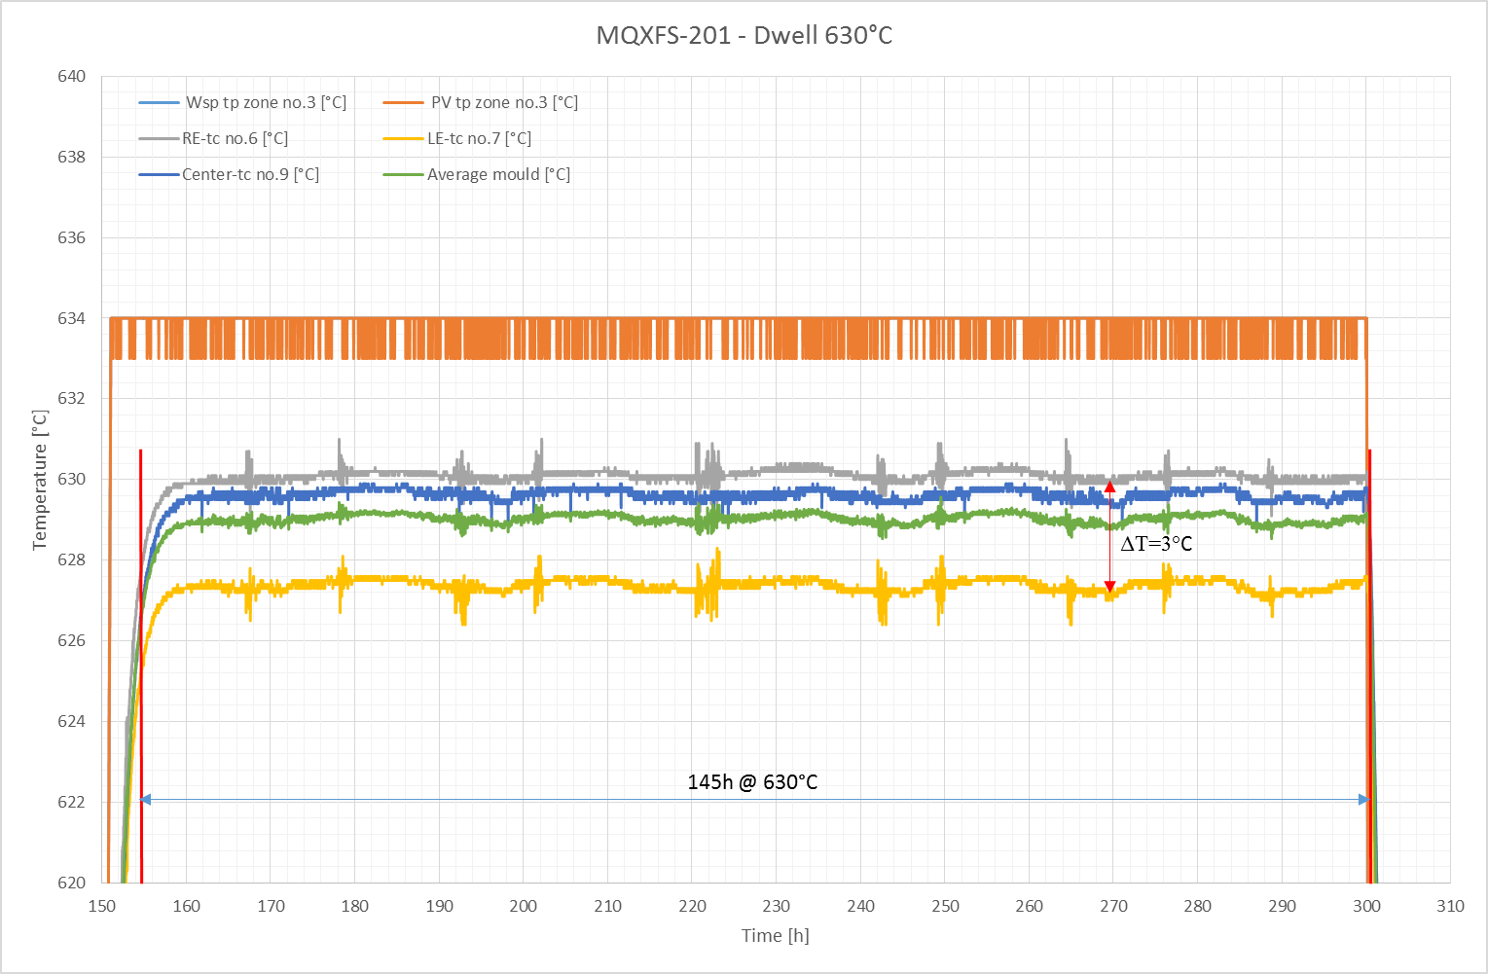

Slide 8
Remarks
No fan
No O2 content measurement
Vamas and RRR samples integrated for the first time in the reaction mold

Slide 9
TE-MSC-MDT

